Slide 1
Movie Dataset Analysis
Data collection and cleaning steps for Movie Dataset
Ogundipe Olorunfemi

Slide 2
CONTENTS
01
02
03
Introduction
Data Collection
Data Cleaning
04
05
Feature Engineering
Data Transformation & Integration

Slide 3
Introduction The purpose of this presentation is to display the data collection, cleaning steps and feature engineering applied to the movie data set intended to be used for creating a prediction model for universal studios.
PART ONE

Slide 4


Overview of the dataset and project objectives
Key dataset features
Project objectives
Comprehensive movie data including titles, genres, ratings, and more. the data set contains details of the top 250 movies of all time based on box office earnings. The data is apporiprate for it’s intended use
Clean the data and eliminate inconsistencies, duplicates and handle missing values
.Understand the factors that influence a movie’s success based on the data
create a predictive model useful for making predictions based on the success of a movie.

Slide 5
Data Collection the data was gotten from kaggle.com and was downloaded in the csv format.the data was then loaded into the python enviroment via jupyter lab for cleaning
PART TWO

Slide 6

Cleaning Steps
Extracted Lead Actor: Trimmed the 'casts' column to retain only the first actor as the lead actor for easy analysis.
Converted to Numeric Values: Removed special characters (like $ and commas) from the 'budget' and 'box_office' columns, converting them to numeric.
Handled Missing Data: Replaced 'Not Available' values and other non-numeric entries in the 'budget' and 'box_office' columns with 0.
Created Budget Yield: Calculated Budget Yield as the percentage of earnings over the budget for each movie.
Generate summary statistics and additional statistics (median, mode).
Check for missing values in columns.
Count unique values in categorical columns (Genres, Directors, Writers).

Slide 7
Data Visualization The following visualizations were done to further explore the data: Bar chart showing earnings for the top 10 lead actors. Bar chart displaying earnings for the top 10 genres. Bar chart illustrating earnings for the top 10 directors. Bar chart of earnings for the top 10 writers. Bar chart showing average movie ratings for the top 10 writers. Bar chart of budget yield for the top 10 movies.
PART THREE

Slide 8
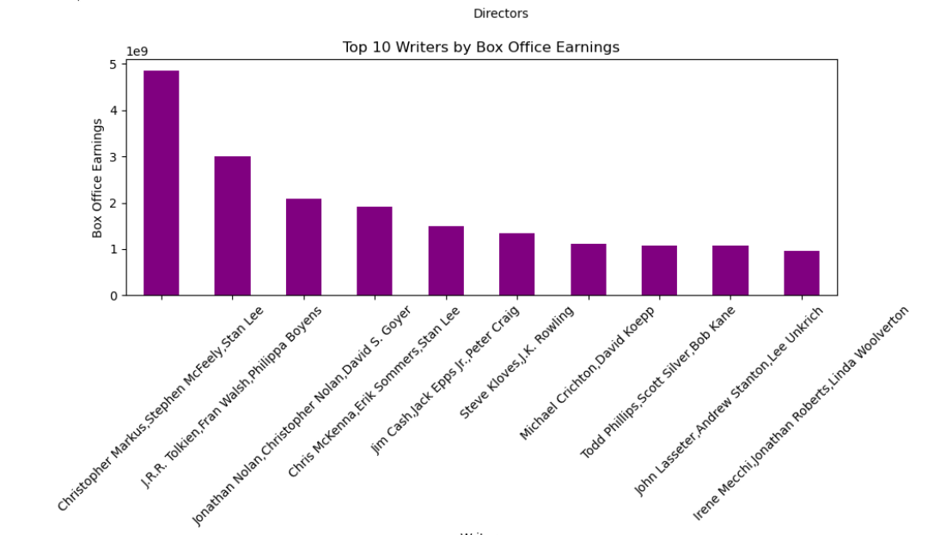
top writers by box office earnings

Slide 9
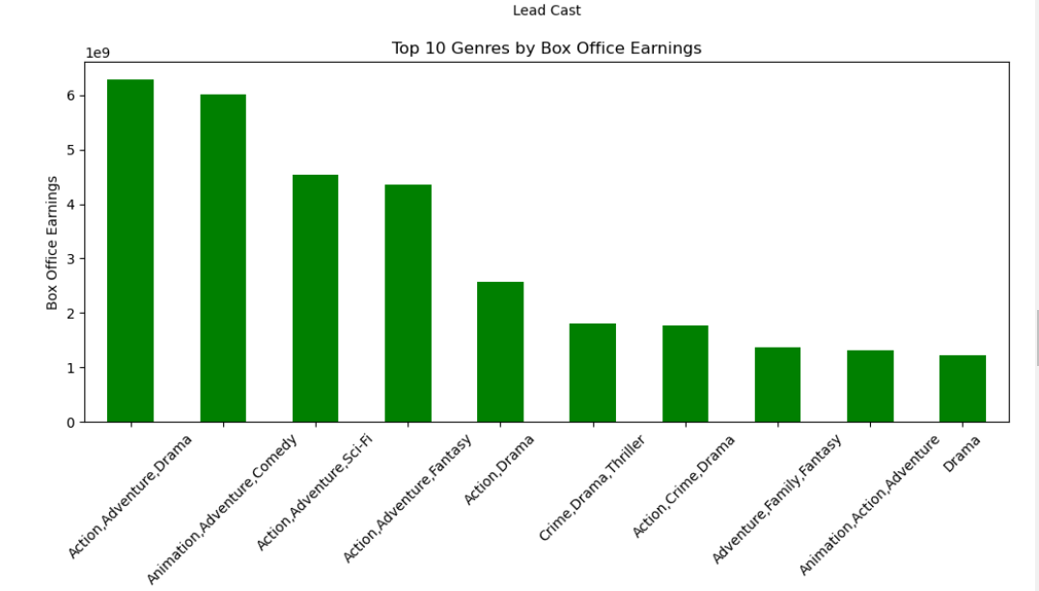
top genres by box office earnings

Slide 10
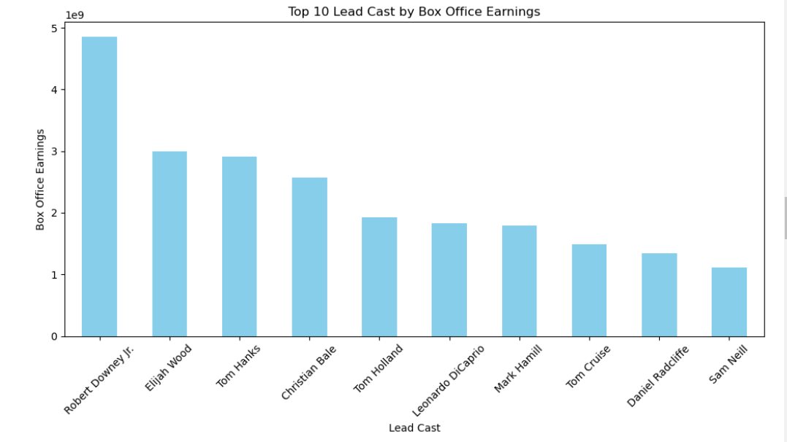
Lead cast by box office earnings

Slide 11
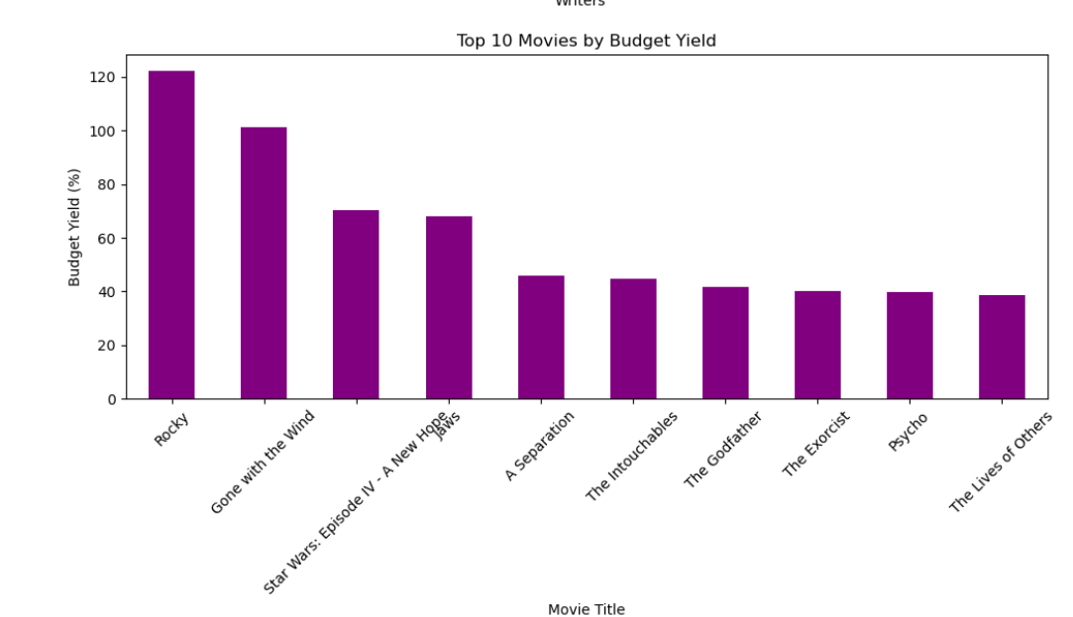
top movies by lead cast

Slide 12
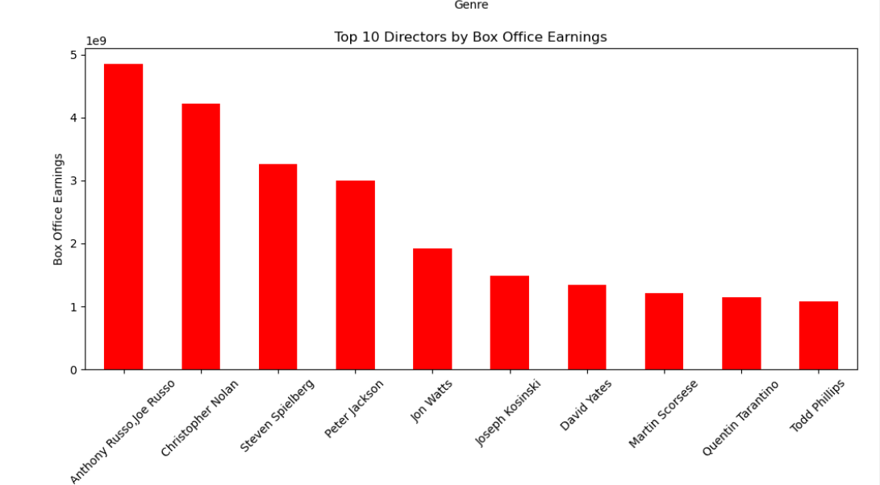
top 10 directors by box office earnings

Slide 13



Key observations from the data
Most Bankable actor
Top Directors
Movies with high budget yield
Robert Downey Junior has emerged as the actor who earned the most money at the box office.
The Russo brothers have emerged as the top directors based on the data .
Rocky and gone with the wind emerged as movies with very high budget yields. meaning the revennue generated far exceeded the budgets

Slide 14
Feature Engineering The major feature engineering carried out was the creation of the budget yield column which looks at the budget movie revenue as a percentage of the budget
PART FOUR

Slide 15
Data Transformation & Integration The amounts in the budget and revenue columns were standardized and non numerical features were deleted or replaced with 0.
PART FIVE

Slide 16
Data Quality Assessment
overall the data quality adter cleaning is very impressive and the data is in a much better state. initially the data contained several missing details, non nemerical values in numerical columns and other inconsistencies and irregularities however i am confident the data is in a good state and is ready to be analyzed to gain insights and for modelling

Slide 17
Thank You
Name

